Slide 1
Transitioning to a career in Tech
by Anton Krug

Slide 2

Congratulation on choosing this course
Was closely involved with this course as tutor for a while
Students do not regrets this choice
Run and curated by smart people
Who know the technologies and the industry
Job opportunities with decent companies

Slide 3
Transition to IT
Bleeding edge technologies
Rapid R&D
Amazing things are happening
Great opportunities to learn
Can’t stop learning!
Stack Overflow/Google are your friends
You can change the world
Few lines of code can improve lifes of many
High job satisfaction in IT

Slide 4
Student to employment transition
Free time
Work / Projects / Code will get used
A lot of responsibility
For some might be scary, but you can get time to adjust
Try to be self organized, do not expect to be micro-managed
Project lead to find a partner for us
Got encouragement and positive feedback from highest management
I was underestimating soft skills
Giving talks. Writing essays/papers. Talking to customers/partners.
Business travel (Shannon, Barcelona, San Francisco demos, Germany paper/talk)

Slide 5
Leadership and the team are very important
Teamwork! Yet another surprise for me as I have heavy on hard skills
It’s great when your boss and your director are your heroes
Learned from them a good bit and have a lot more to learn
No unnecessary meetings
Strong culture, focus on important but not urgent tasks
Fridays dedicated to learning new skills

Slide 6
Resources and perks
Corporate infrastructure/servers
Personal Xeon workstation and a server rack
Free books / training (on-site or travel)
Free HW/SW tools for work/projects
Decent health insurance (for example: physio, relaxing massages covered)

Slide 7

18k employees
For a big corporation we didn’t lost the human feel
High management encourages people and cares about them
Lot of flexibilities, freedom and power
Your input is taken seriously (it’s rewarding)
Not a spot-light company (we are not Apple...)
BUT we are behind the scenes everywhere
And in many markets we are THE industry leader
Diverse
From chips costing cents and selling huge volume
To very expensive chips selling lower volume

Slide 8





Aerospace / Space / Defense
Radiation tolerant and system critical instant on SoCs
Great reliability, power and security features of FPGAs
International Space Station PSU
Machine Learning inference
1500 cores, each core can do 8 operations per single clock
24 SERDES lanes, combined 300Gbps throughput
Very power efficient
Automotive/Communications/Data centers/Industrial/Medical
PCI-E server GPU switch
NVMe SSDs, self-encrypting and self-destructing SSD storage
Critical Timing (GPS)

Slide 9
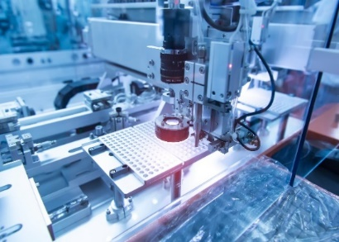
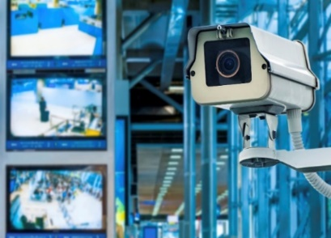
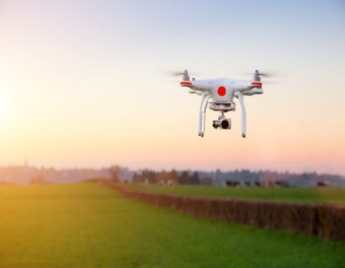

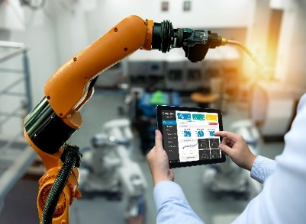
Smart Embedded Vision
Low power, high-speed, secure, real-time applications
Machine
Vision
Secure communication
High speed I/O
Surveillance Systems
4k Resolution
Image sensor muxing
Drone Cameras
Low Power
Hi-Reliability
IP security
Medical
Imaging
Security
High speed I/O
Instant On
Machine Learning
Hi-Reliability
High Speed I/O
4K Resolution
Notes:
Largest potential for growth in industrial market

Slide 10
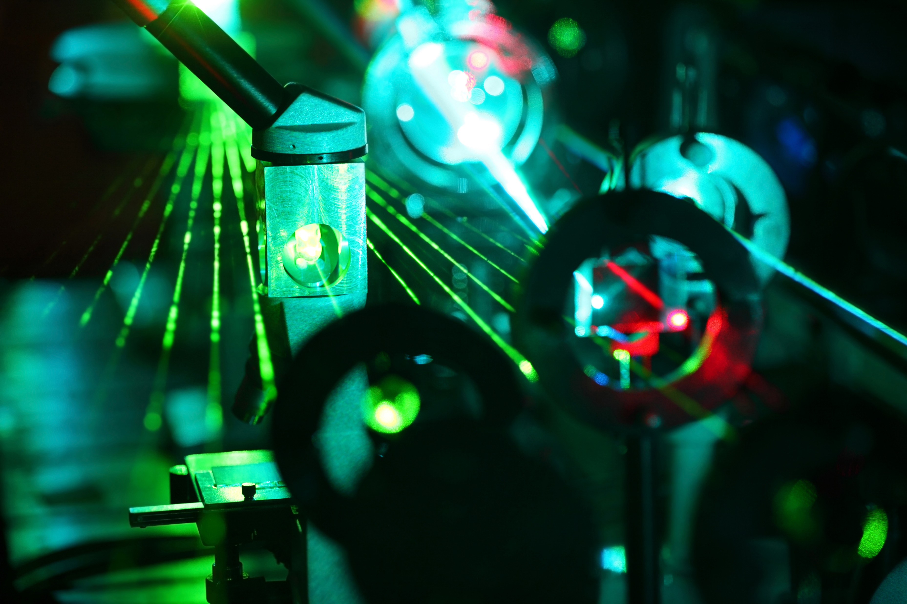

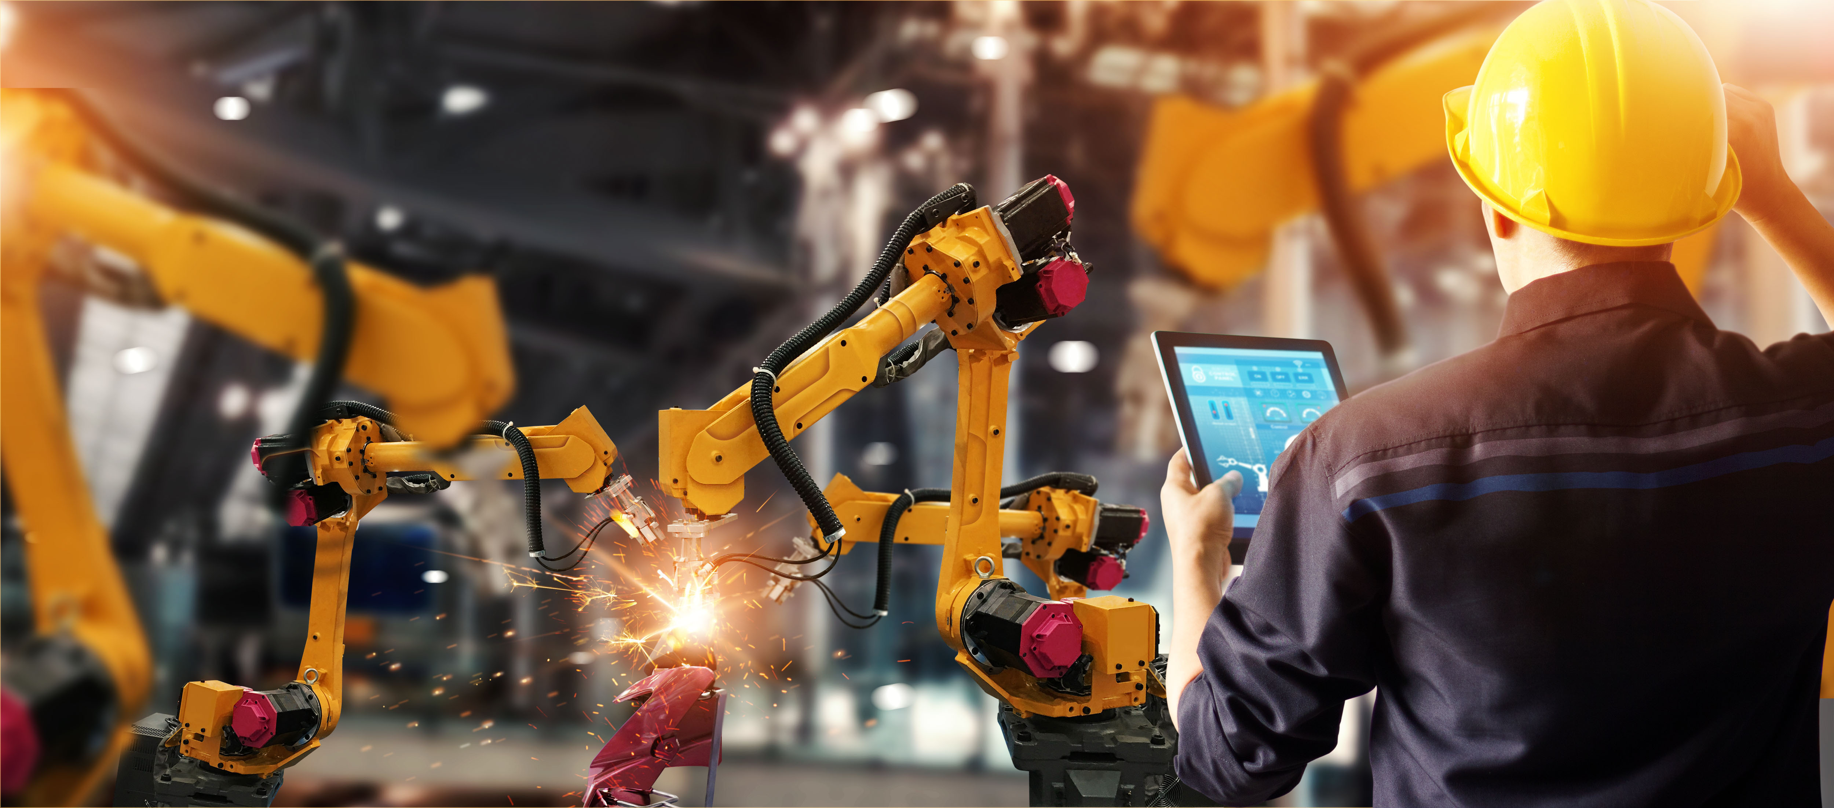
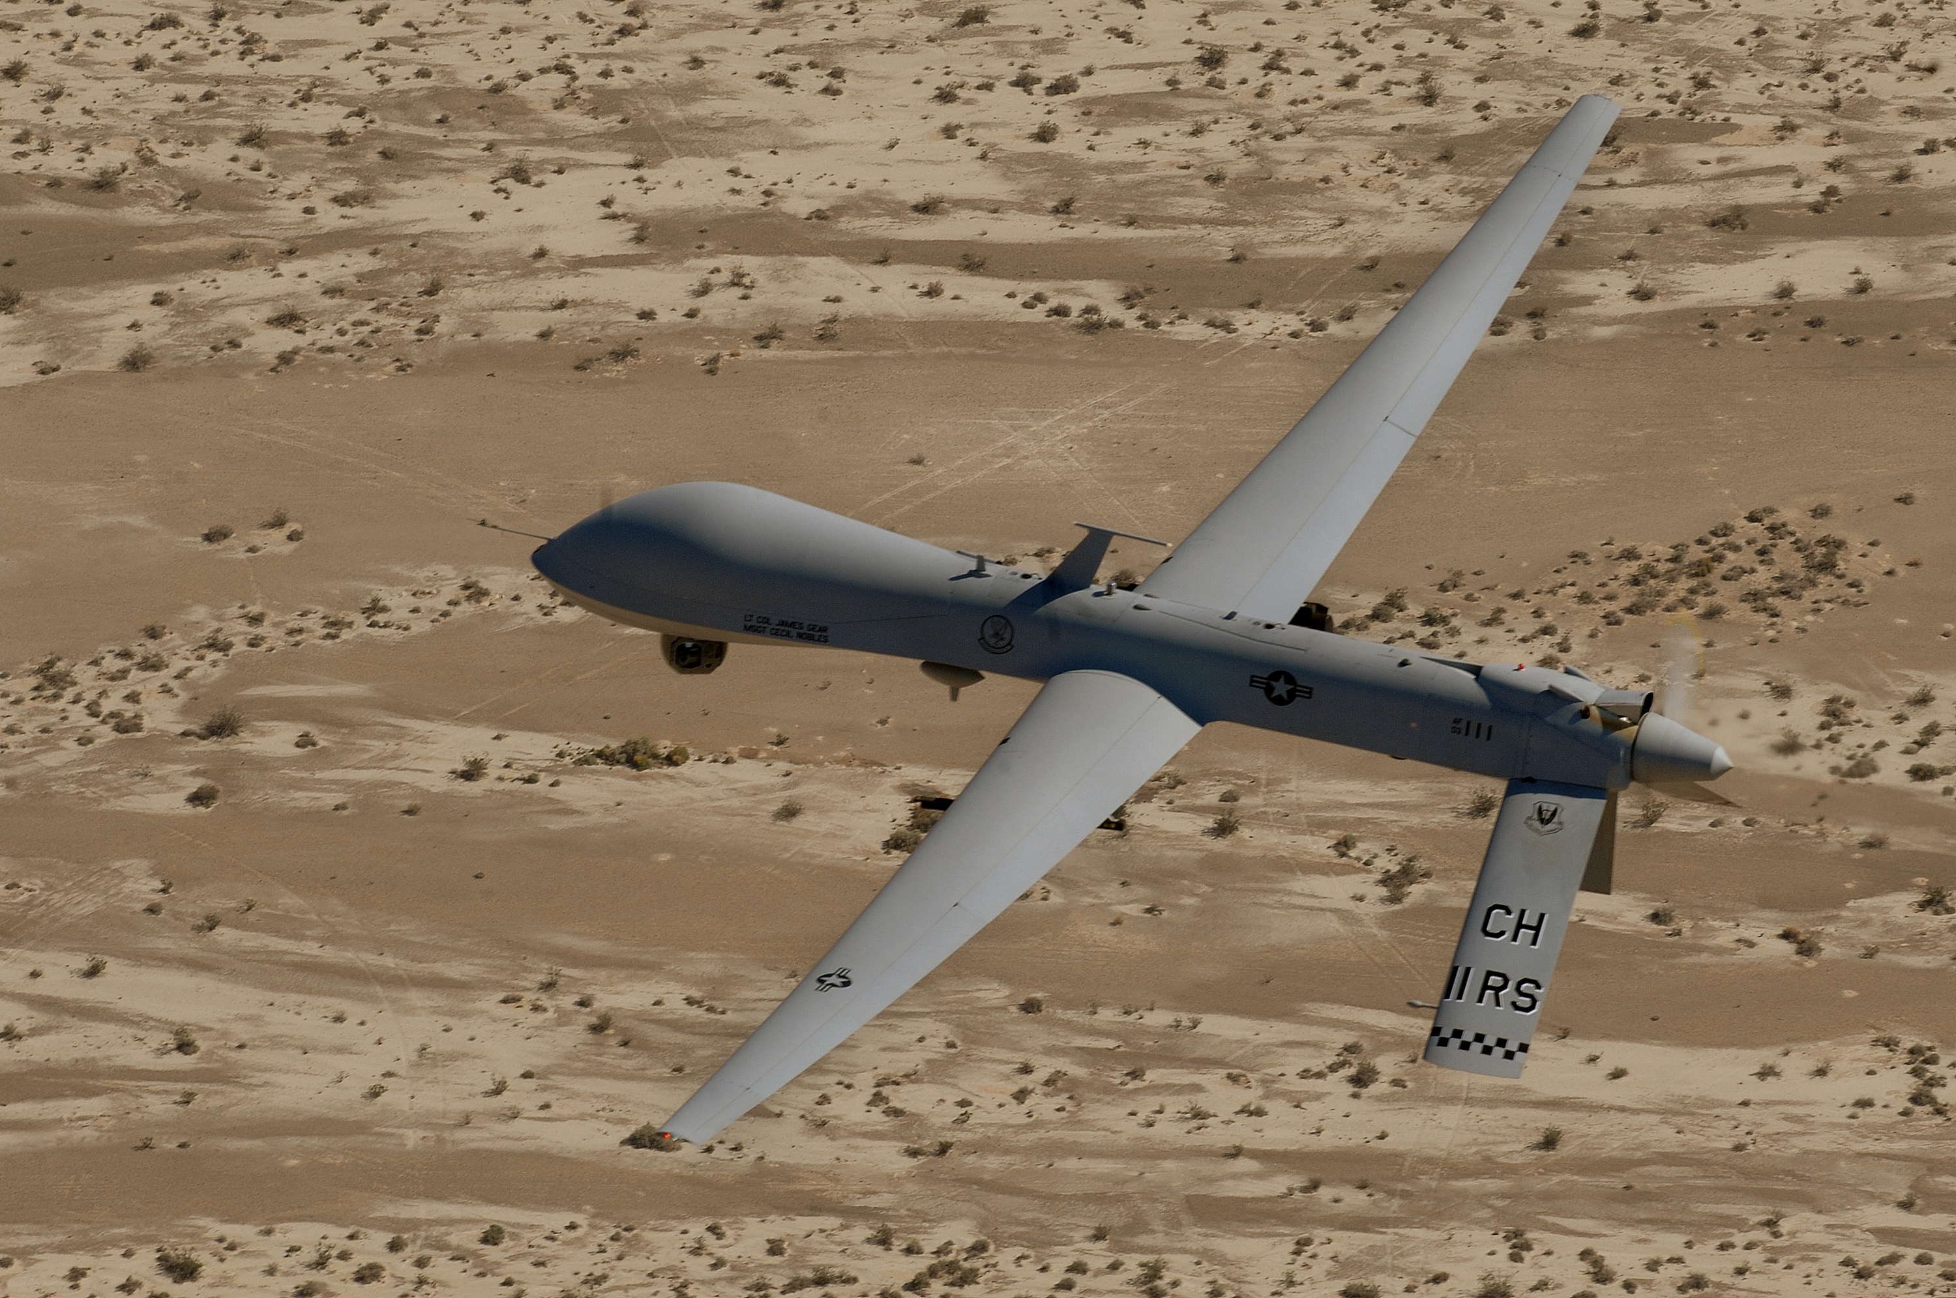


Real-time, Low Power systems
Collaborative Robots
Safety Critical Systems
Imaging and Machine Learning
Secure Communications and Portable Embedded Systems
Smart Weapons, Drones and UAVs
Industrial IoT

Slide 11
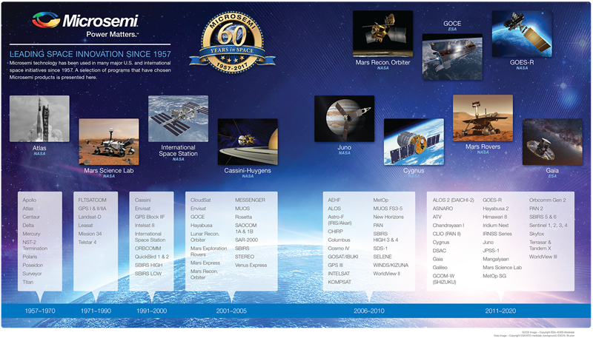
Notes:
Largest potential for growth in industrial market

Slide 12

RIP Opportunity
Our FPGAs are very robust
Planned 90 sols
Survived 5352 sols
Notes:
Largest potential for growth in industrial market

Slide 13



Slide 14
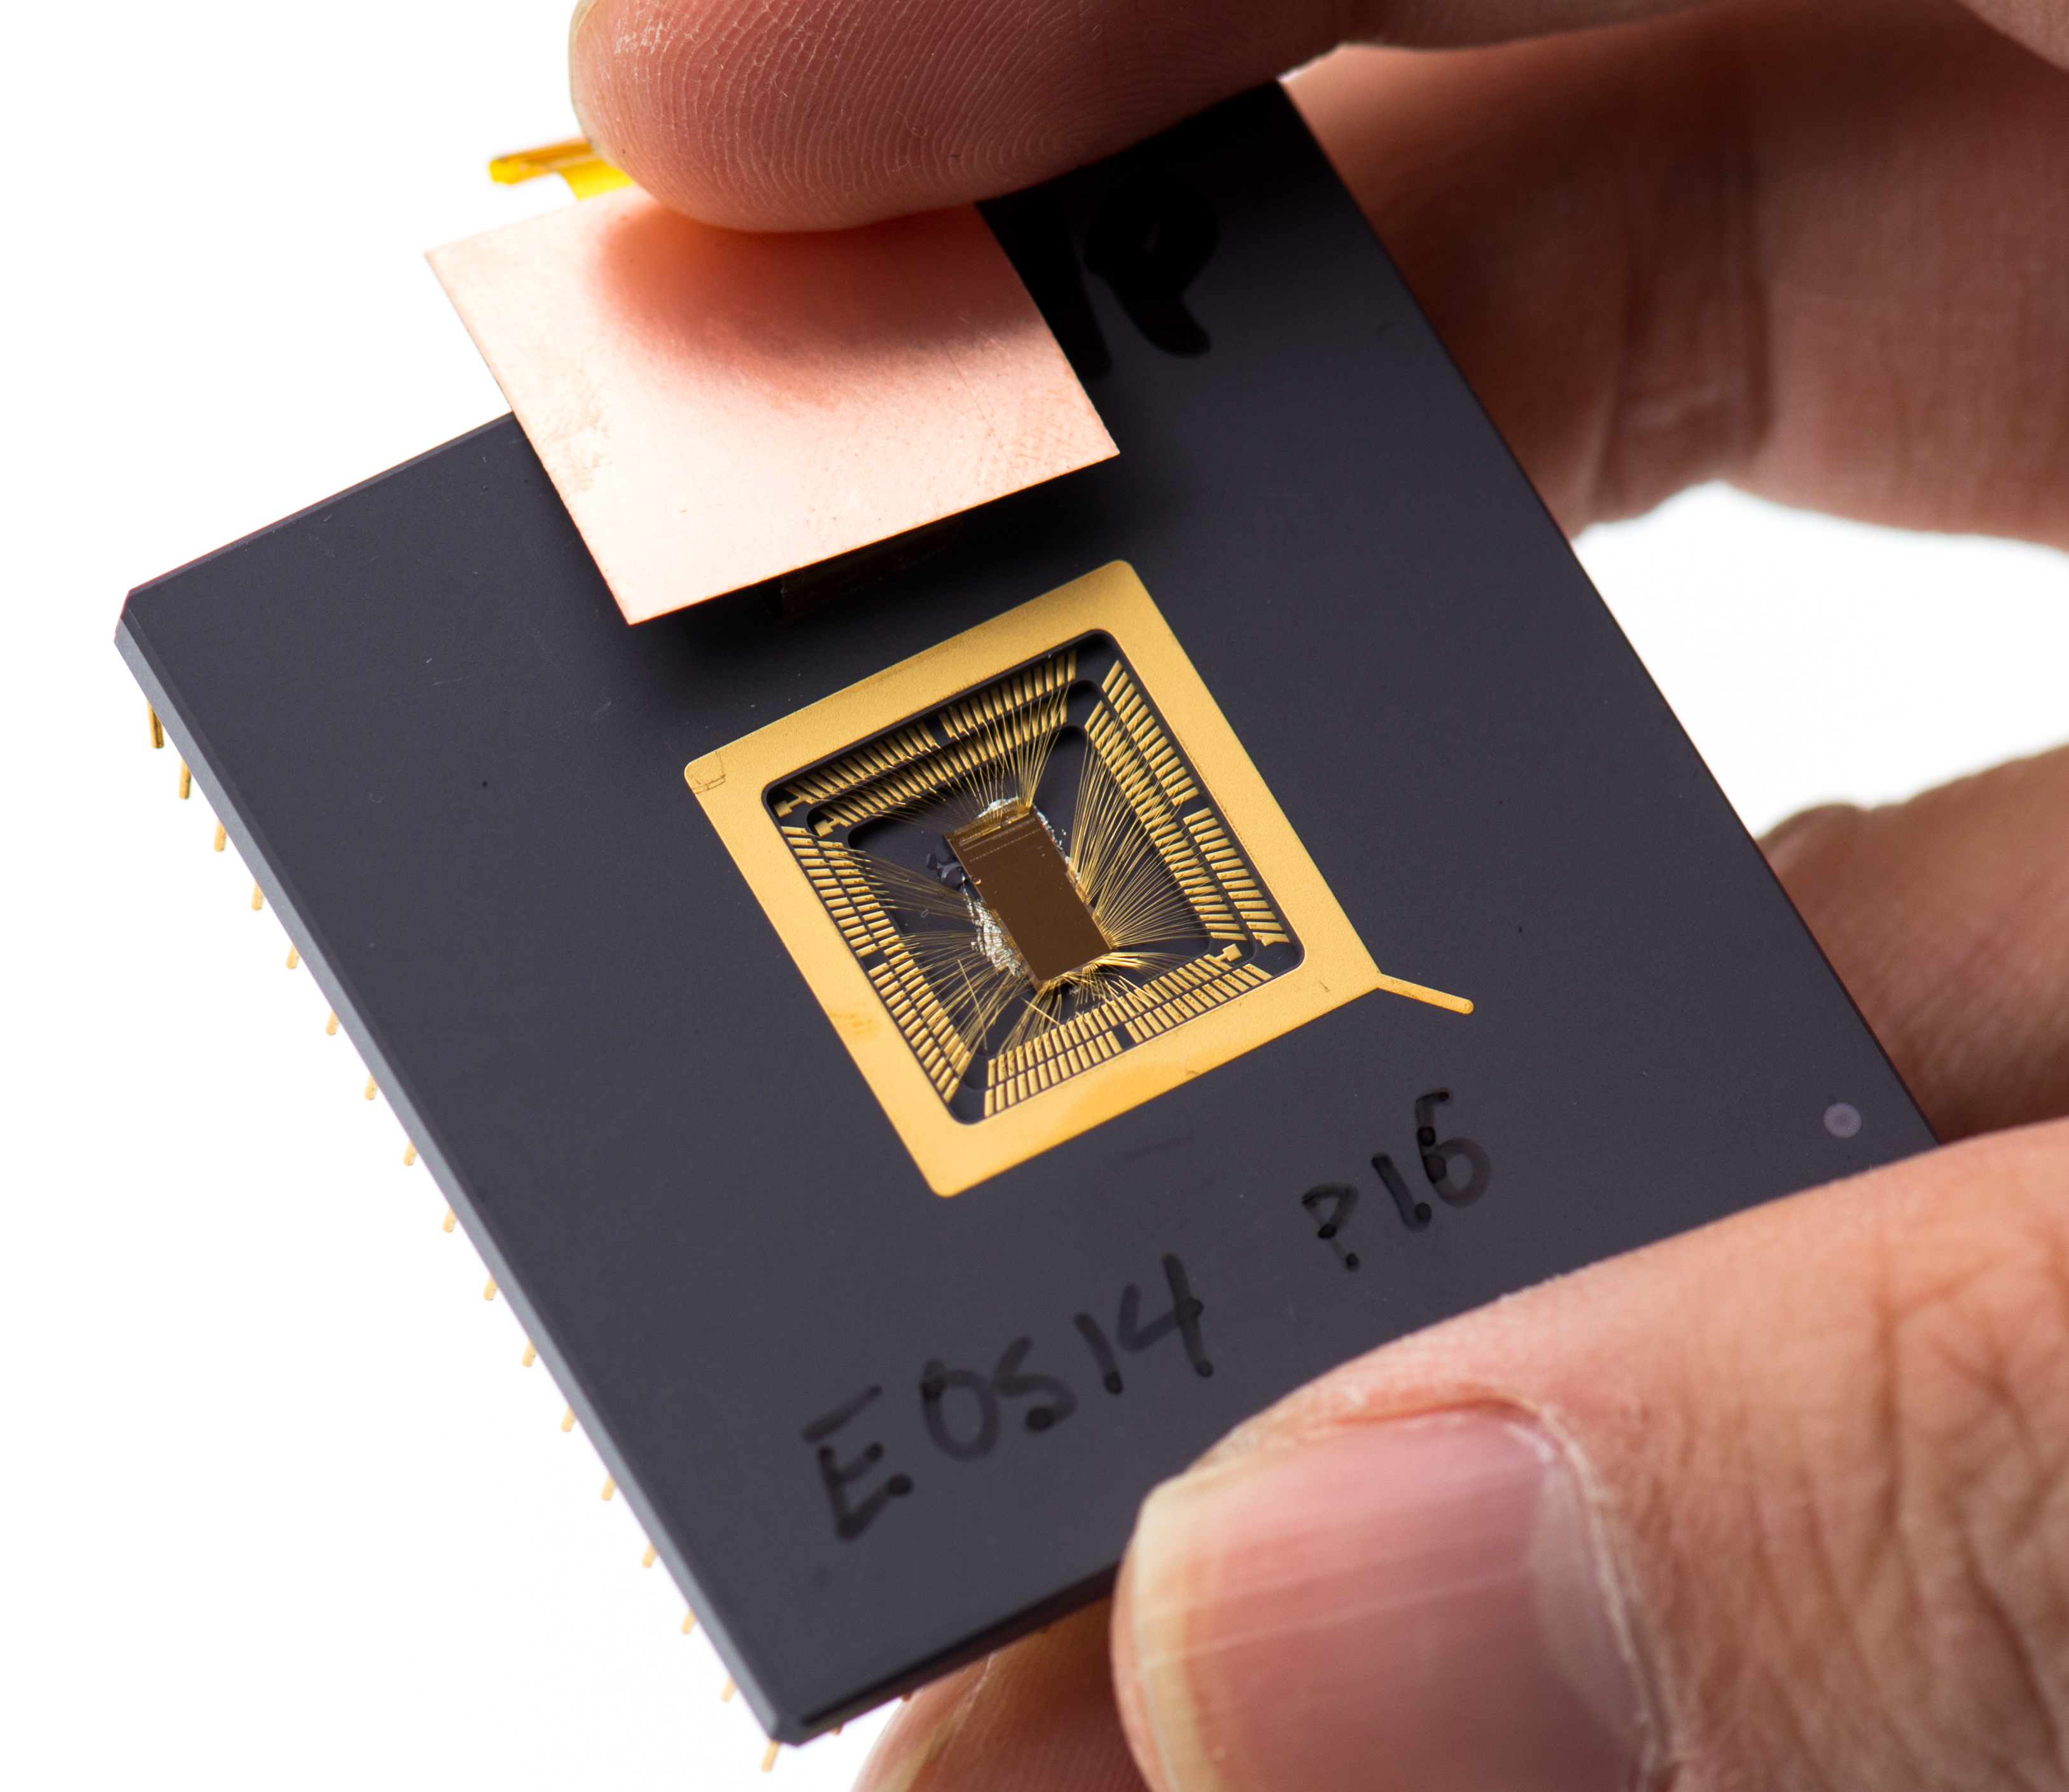

Like Linux OSS revolution but in HW
Running free SW on free HW
First open ISA capable of running Linux
Safe: No spectre/meltdown vulnerabilities
From small a microcontroller to a supercomputer
32-bit / 64-bit / 128-bit CPUs
Not vendor locked, skills are transferable
From Java/Scala to C/C++/assembly to HDL languages and many other
Giving input (ebreak, csr), fixing stuff (Andrew’s book)
Meting great people/engineers/architects (SiFive, IBM, Google...)
Us, Si-Five and NVIDIA
Guess current members?

Slide 15


















Foundation: Platinum Members

Slide 16











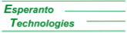



















































Gold, Silver & Auditor Members

Slide 17
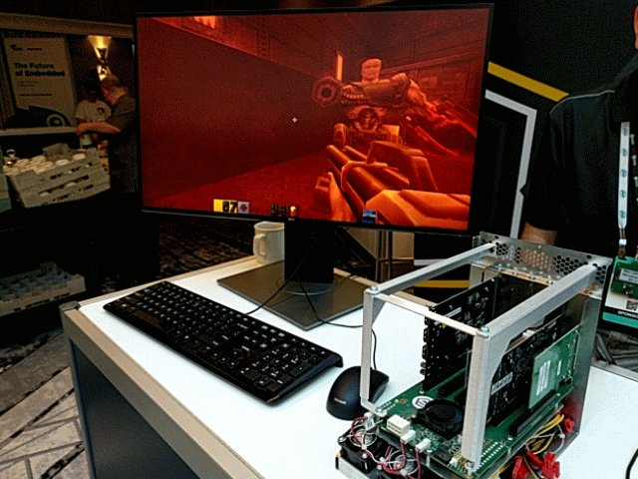
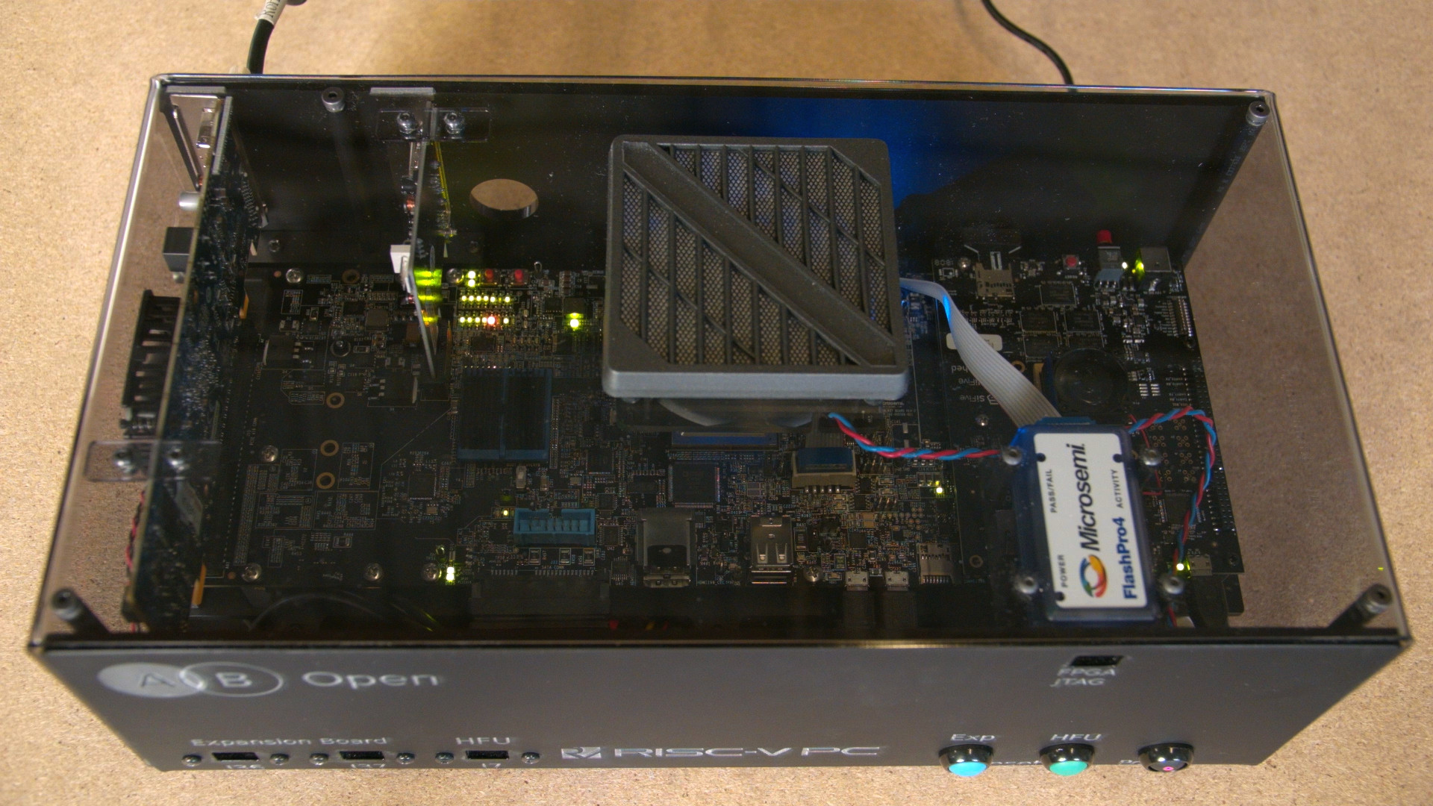
Photos: Drew Fustini, AB Open

Slide 18
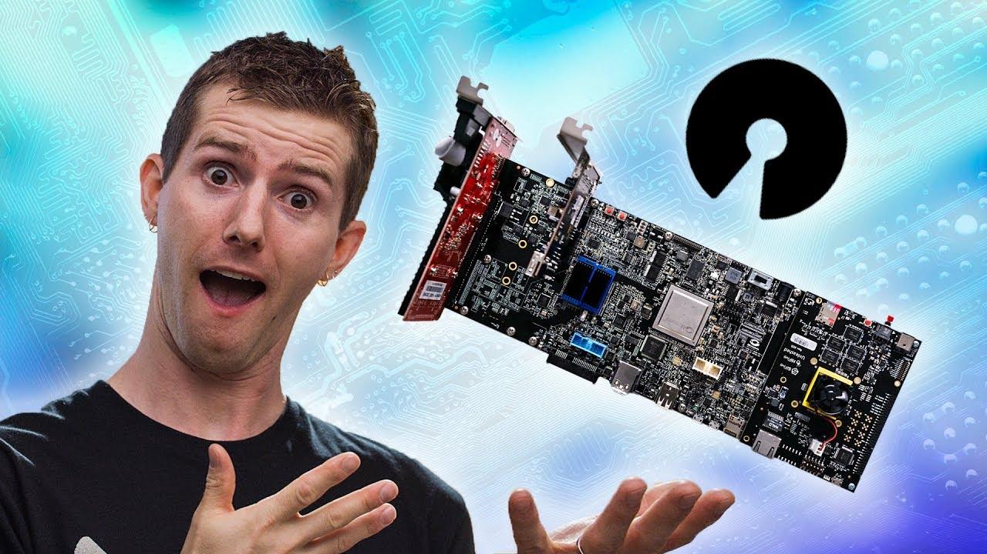
Photo: Linus Media Group

Slide 19
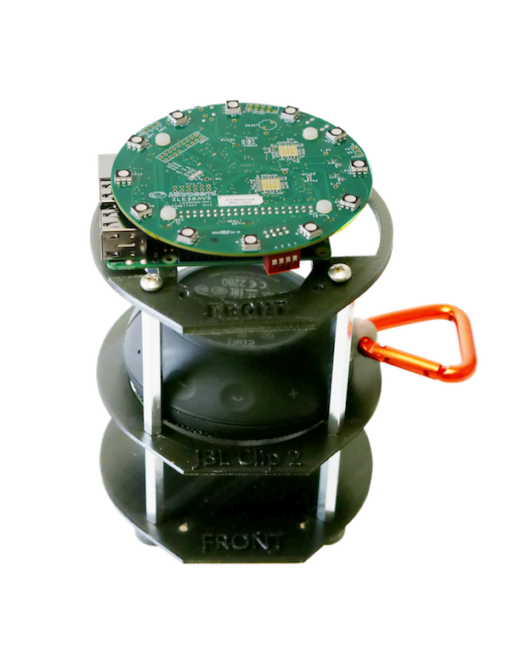
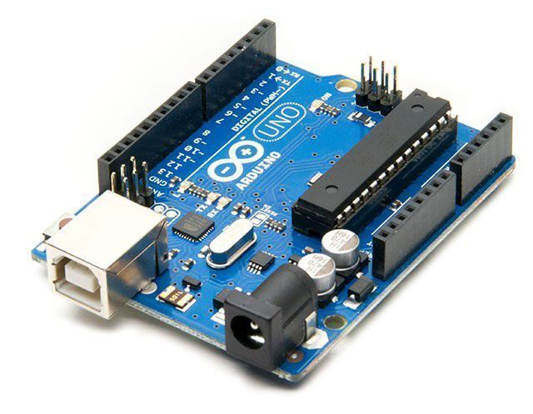
High volume market of consumer devices (I do not get involved in these)
Arduinos
Devices everywhere (Amazon Echo)
IoT / Cloud
Many others

